Slide 1
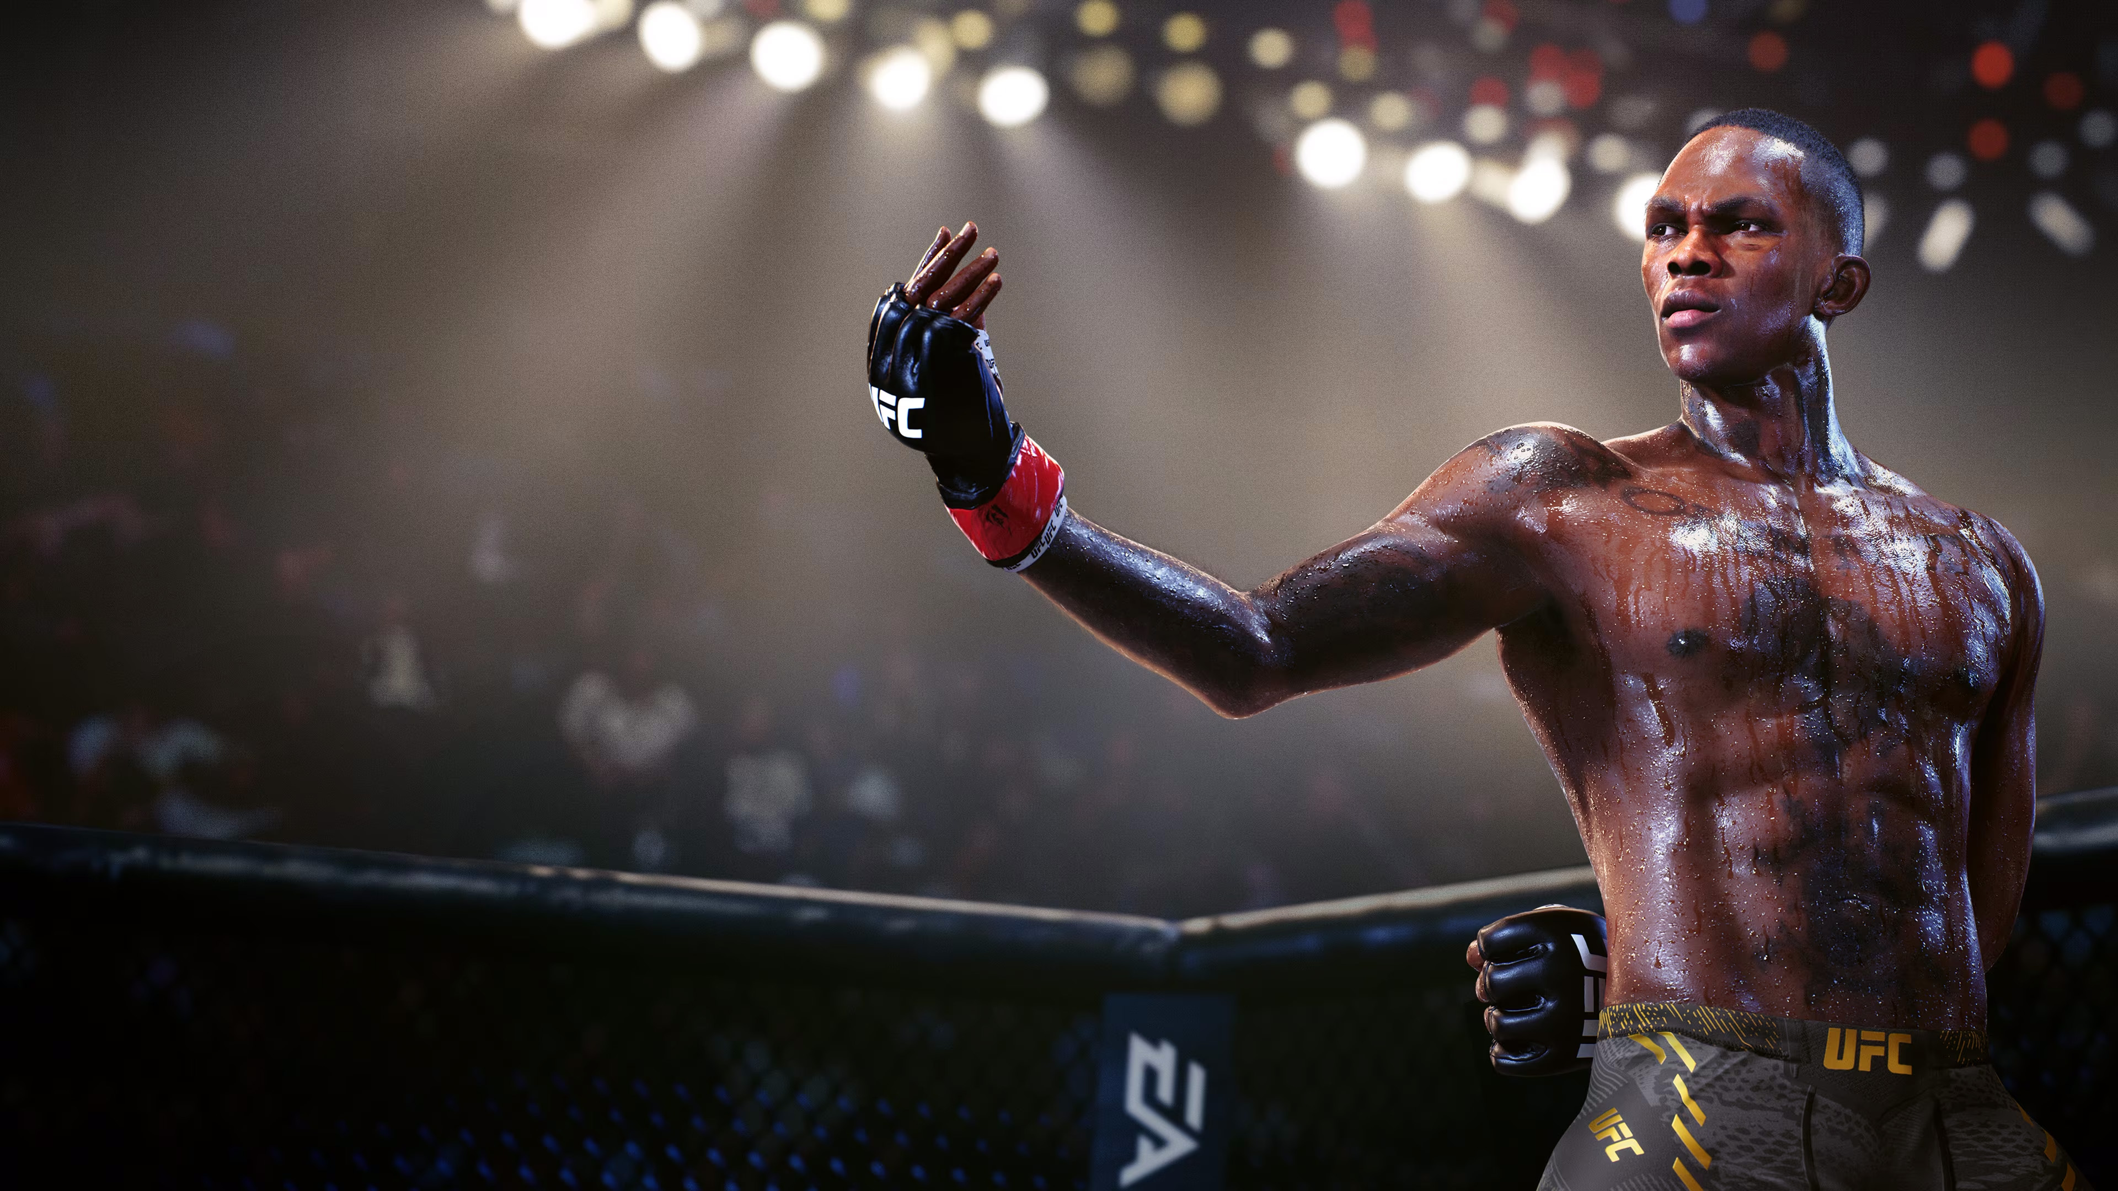
UFC
UFC
data over time
from 1994 until 2021

Slide 2
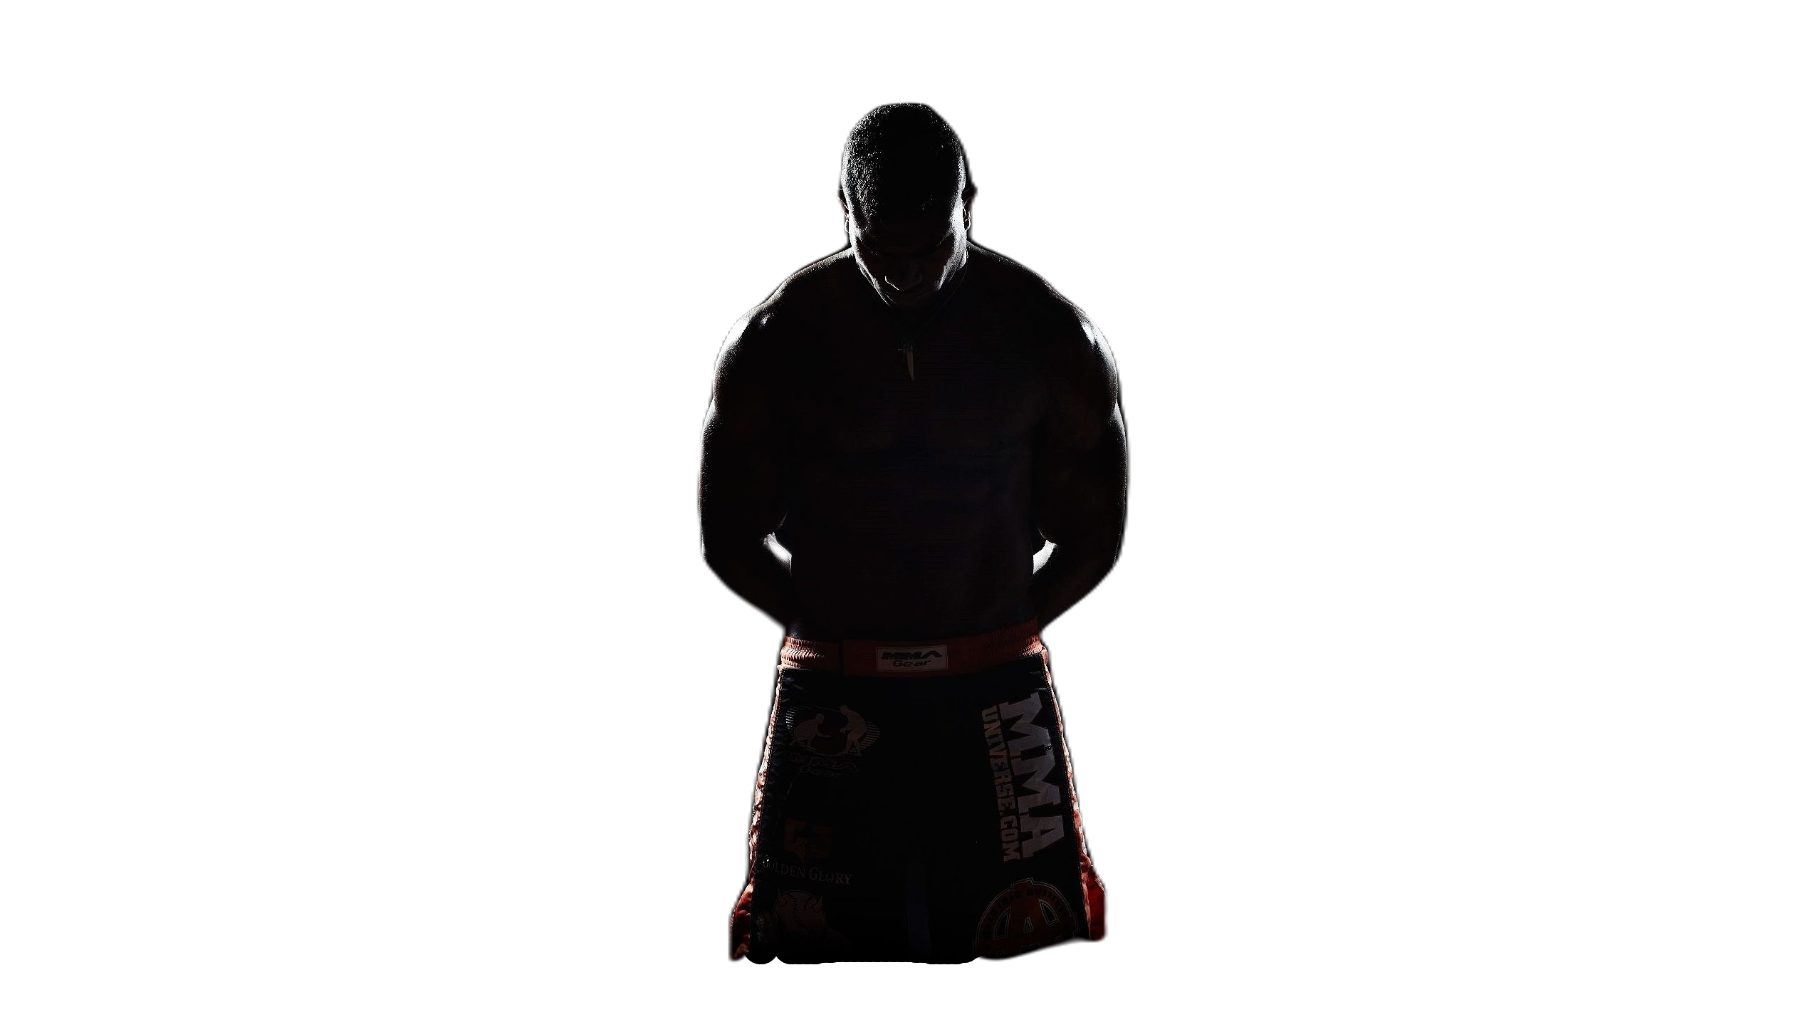
Since 1994, thousands of athletes have participated in the UFC. Thousands of fighters from around the world.
fighters…
fighters…
fighters…
Over the period from '94 to '21, 3,630 fighters have been part of the UFC, out of which 1,895 have experienced a professional fight.
839 fighters from USA
data from 2016
166 fighters from Brazil
data from 2016

Slide 3
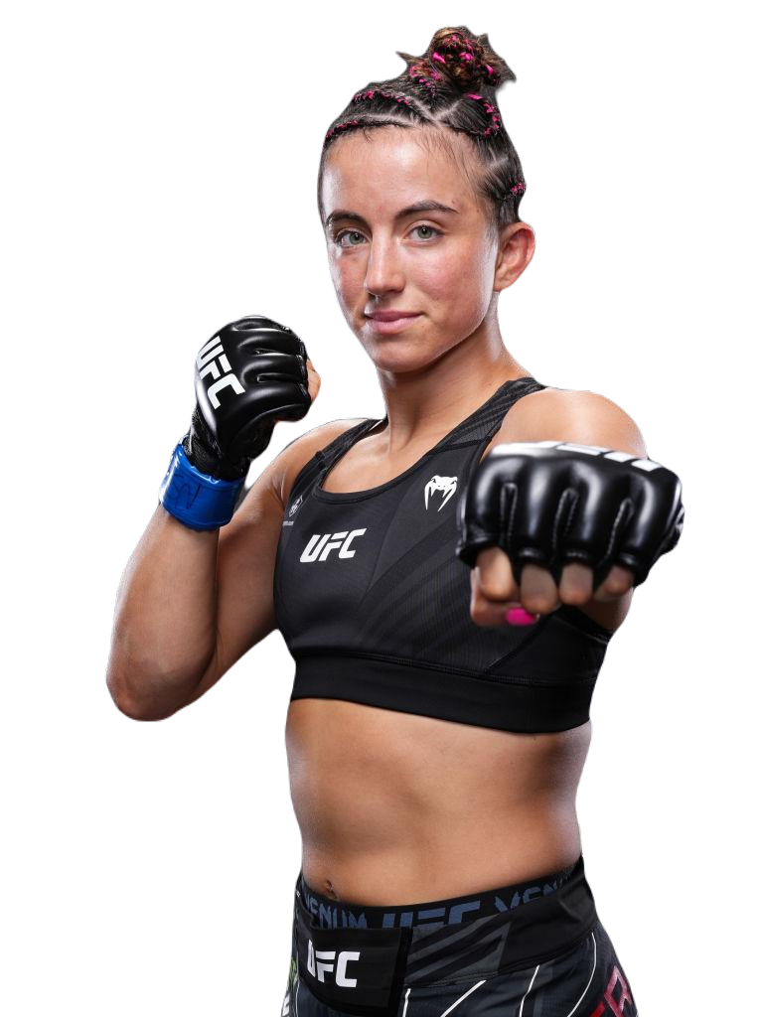


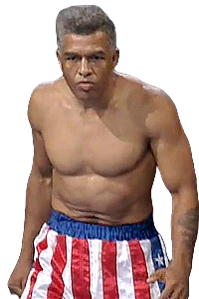
fighters…
fighters…
fighters…
MMA is full of both young and seasoned fighters… However, only the most experienced fighters come to the UFC.
Can you guess how old was the oldest UFC fighter?
Ron Van Clief was just shy of 52 years old at the time of his fight, it was '94.
The youngest fighter Chase Hooper was 20 years and 97 days old on the day of the fight.
The The youngest participant in the UFC - Maycee Barber at the time of the fight was 20 years old.
The oldest woman in the UFC was WIBA World Champion Marion Reneau, who was in the time of match 44 years old.

Slide 4
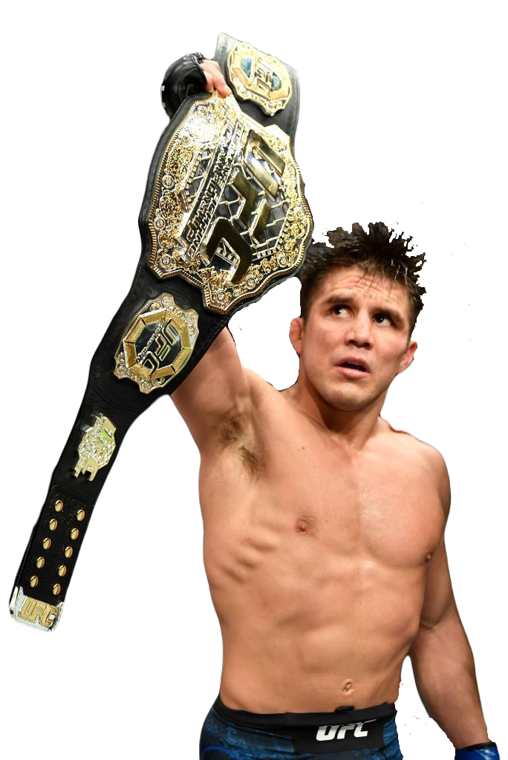
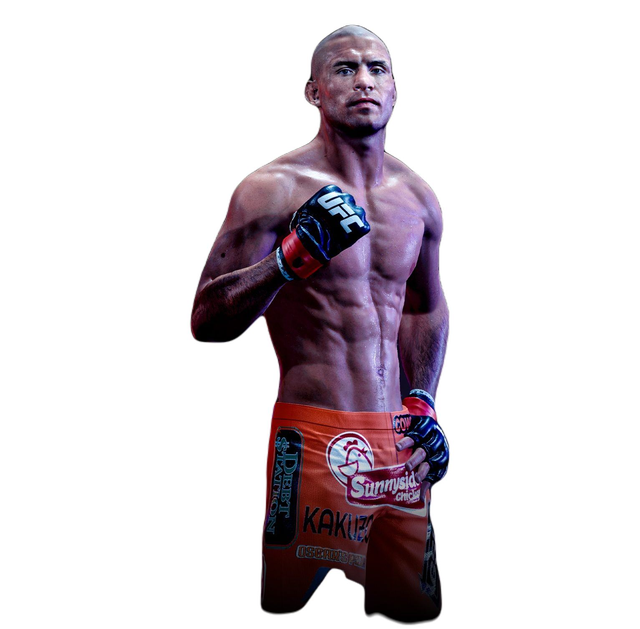
Top 10 most successful UFC fighters between 1994 and 2021.
"If you have a dream, don't let anyone talk you out of it.„ Henry Cejudo
Can you guess how much will it cost you to watch such a fighter in the octagon?
The number of wins for the top ten fighters
The average price for UFC tickets can range between 200$ to 400$. The best seats near the octagon can cost thousands of dollars.
fighters…
fighters…
fighters…

Slide 5



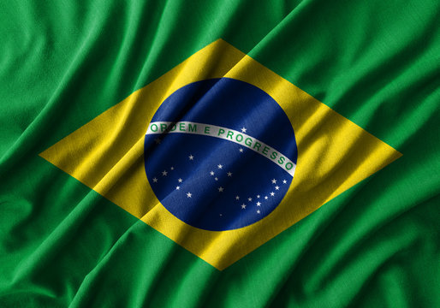
Cities around the world where UFC events are held. between 1994 and 2021.
1451 fights in Las Vegas
The absolute mecca of UFC fights is Las Vegas, where, on average, one UFC event has been held each month since 1994.
Hosting a UFC event can cost (according to ChatGPT research) between 2 to 10 million dollars. However, the revenues are high.
where…
where…
where…

Slide 6
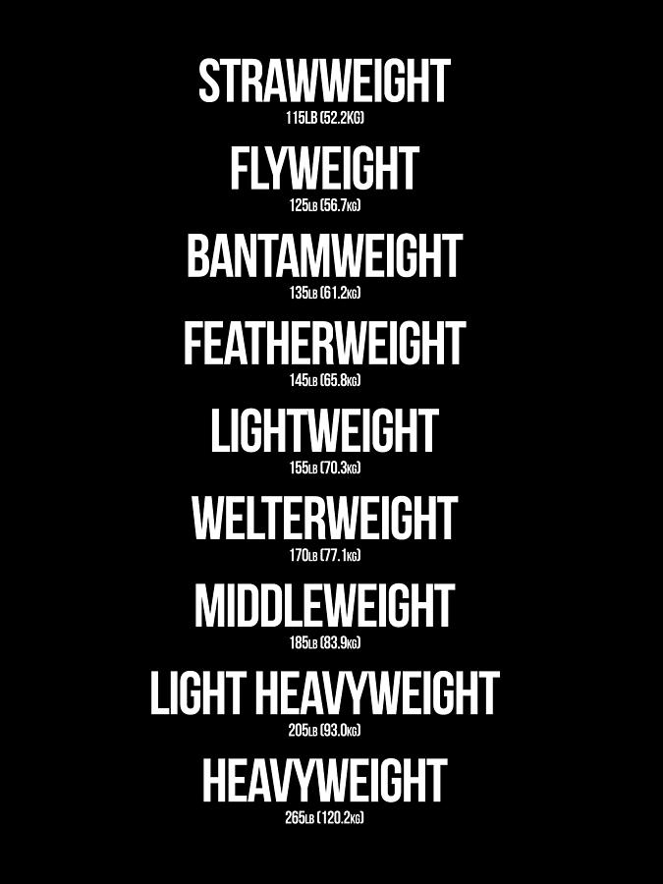
As of March 2021,
5,718 fights have taken
place within the UFC
organization in the
following categories:
The number of fights in each women's category.
The number of fights in each men's category.
categories…
categories…
categories…

Slide 7
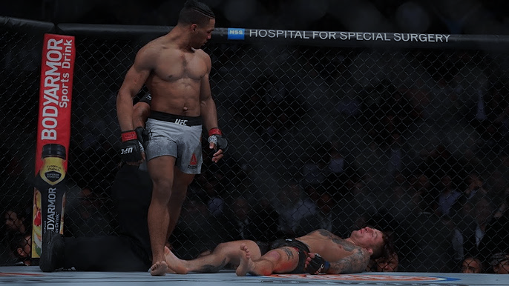
How did the UFC fight end?
The end of fights in men's category.
The end of fights in women's category.
categories…
categories…
categories…

Slide 8
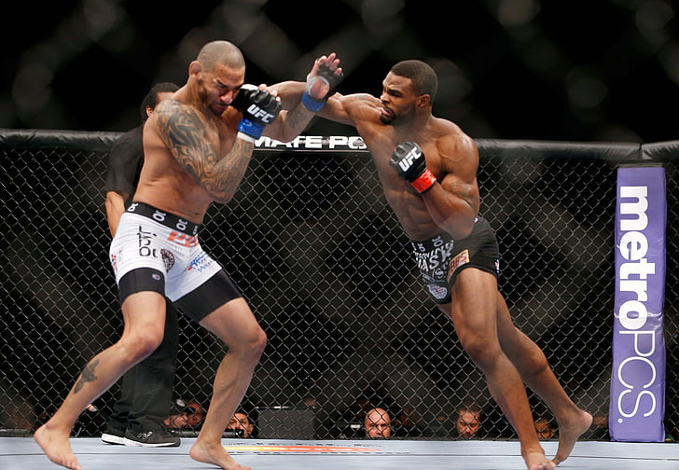
The toughest & most dangerous guys in the octagon within the UFC.
Knockdowns
Significant strikes
Here you can find the number of knockdowns by individual fighters as well as their significant strikes. Knockdowns are listed over the course of their careers, while significant strikes are provided as an average per fight.
fighters…
fighters…
fighters…

Slide 9
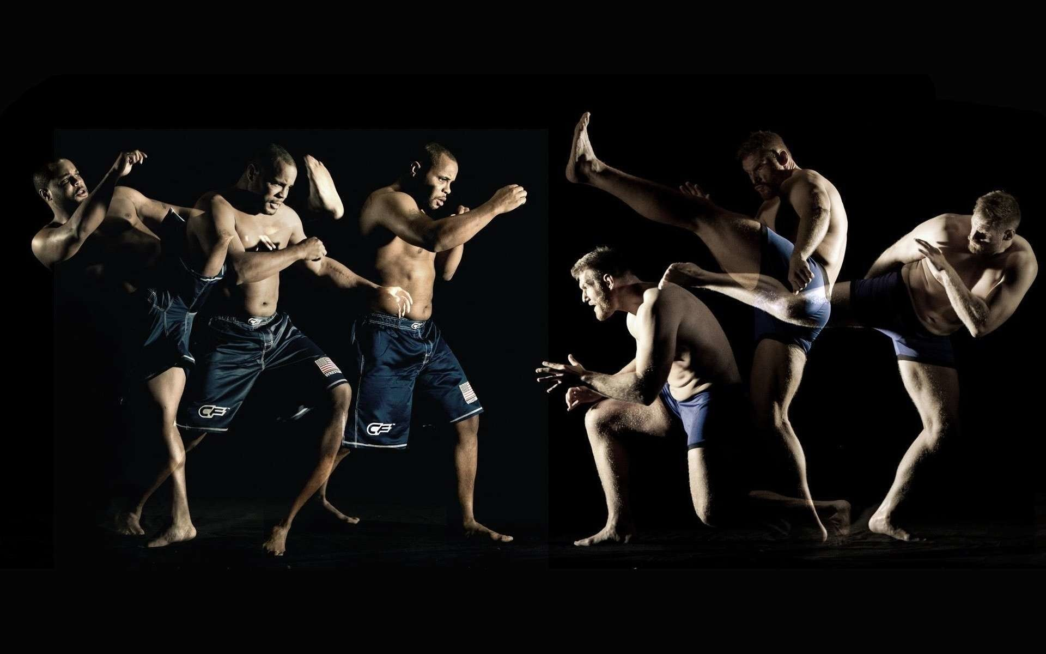
UFC
UFC
data over time
from 1994 until 2021

